Slide 1
Agricultural Drains, Part 2
In-Class Task Script
CE En 547
Brigham Young University

Slide 2
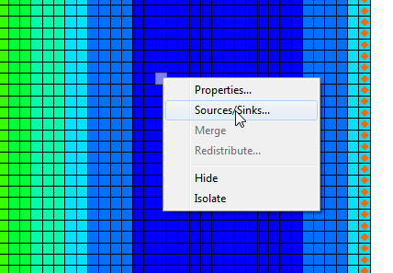
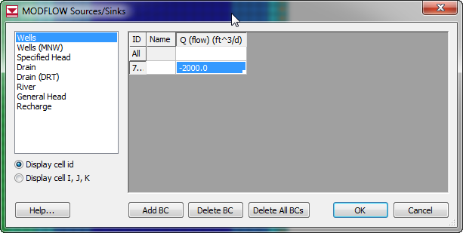
1a. Add a well in the interior

Slide 3
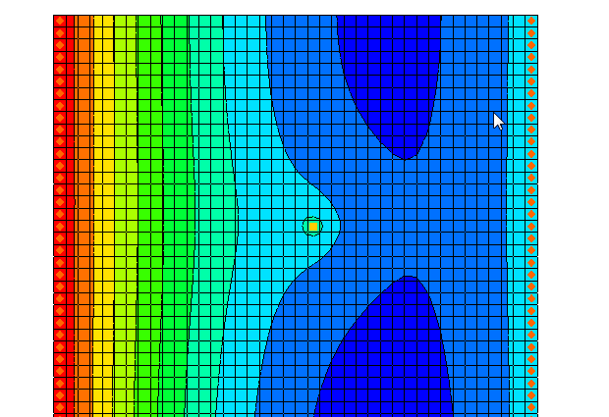

Slide 4
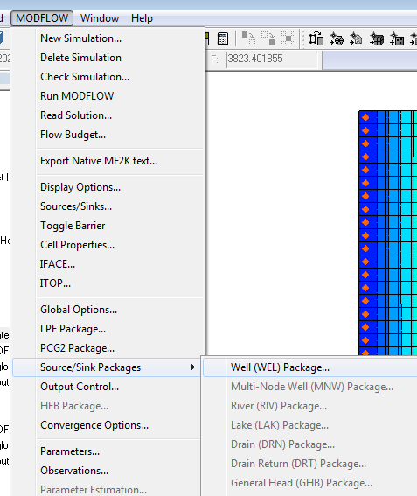
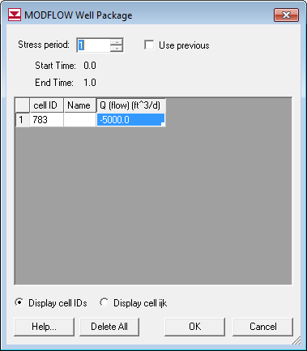
1b. (diff pumping rate)

Slide 5
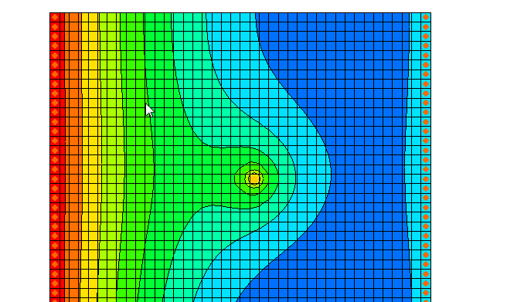

Slide 6
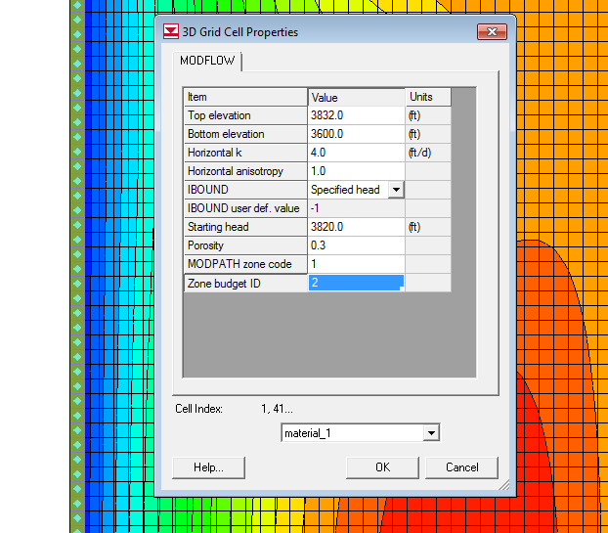
2a. Flow Budget – change zones

Slide 7
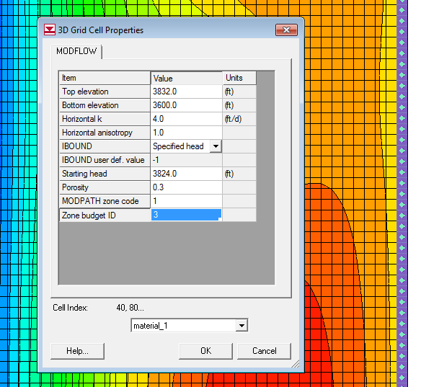

Slide 8
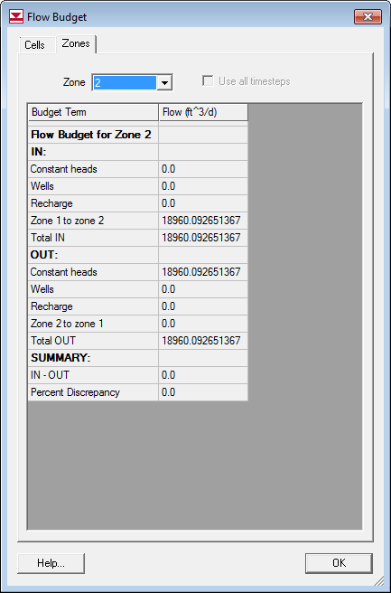
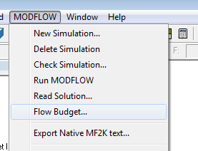
2b. View Budget

Slide 9
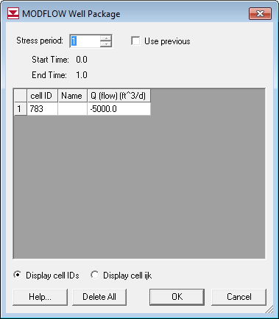
2c. Remove Well and Re-Run

Slide 10
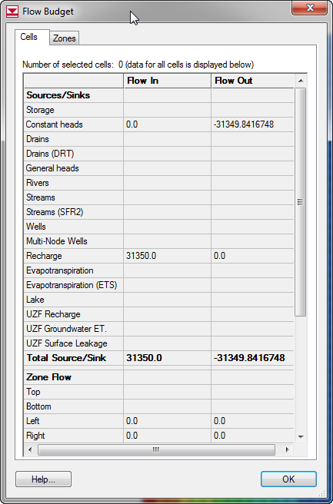
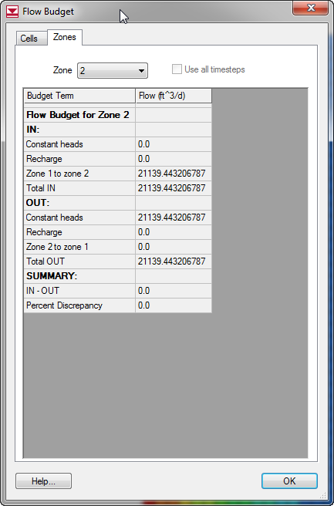
2c. Flow Budget

Slide 11
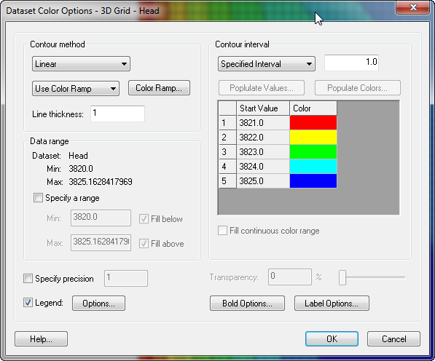
3a. Set contours to fixed interval

Slide 12
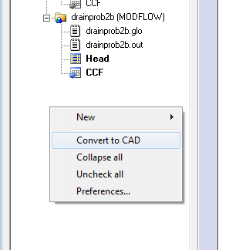
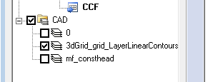
3a. Convert to CAD

Slide 13
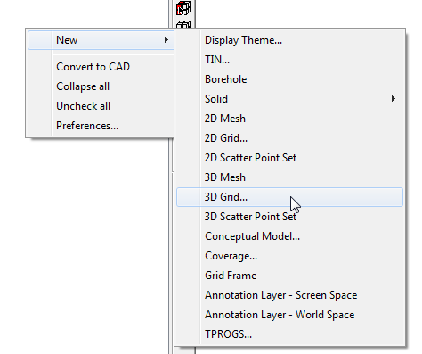
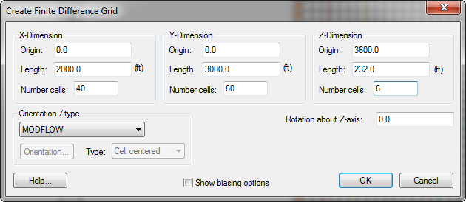
3b. Rebuild the Model

Slide 14
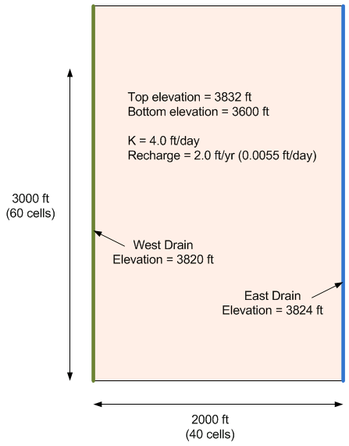
Redo previous steps
Be sure to set HK/VK ratio to 1 (default is 3) or change VK option and set VK to 4.0

Slide 15
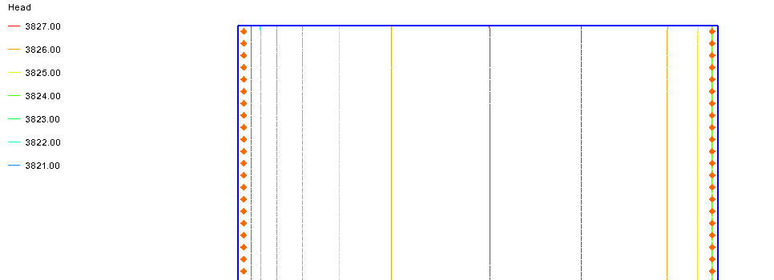
3c. Compare Contours
Not much difference

Slide 16
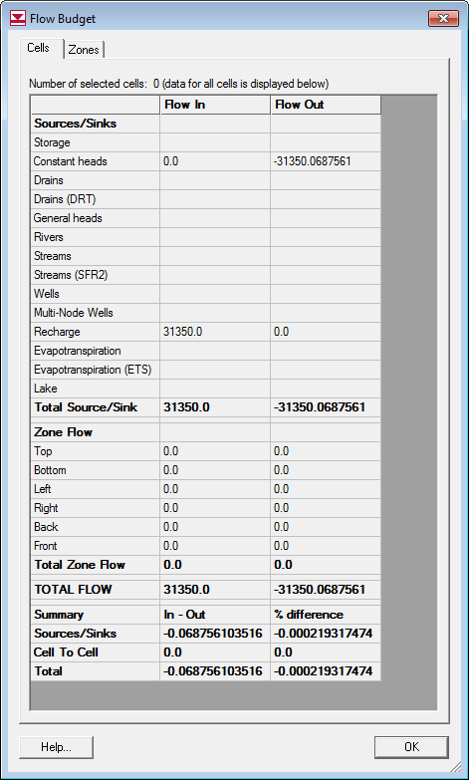
3d. New Flow Budget

Slide 17
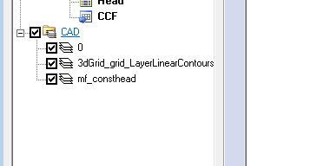
4a. Save Another Copy of Contours

Slide 18
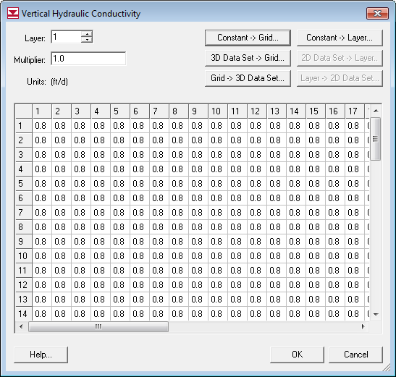
4b. Change VK=HK/5=0.8

Slide 19
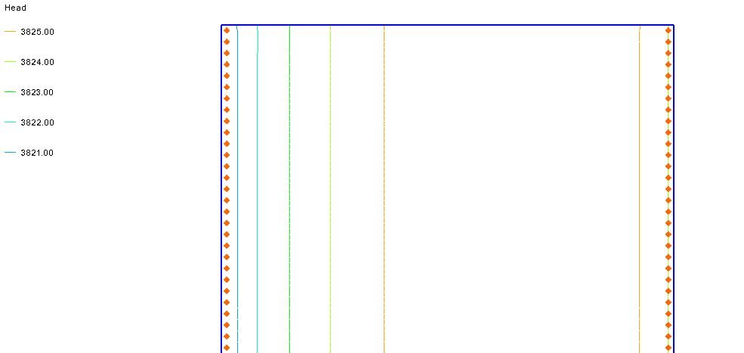
Compare
Flatter water table surface

Slide 20
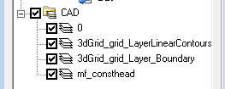
5a. Save another copy of head contours

Slide 21
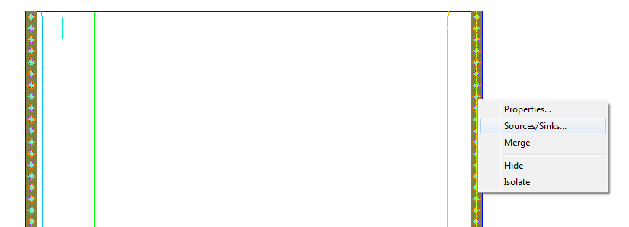
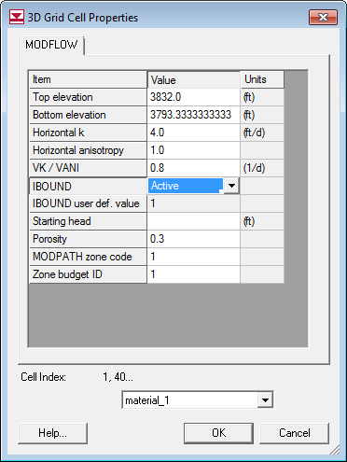
5b. Remove Head BC

Slide 22
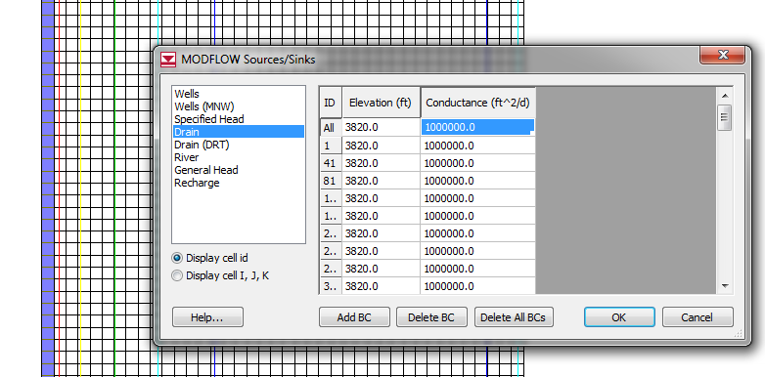
5b. Add Drains

Slide 23
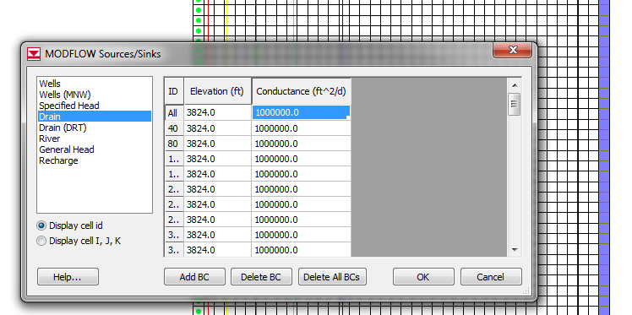

Slide 24
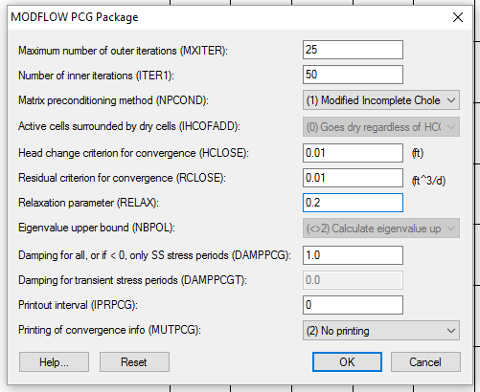
5c. PCG Solver and Options

Slide 25
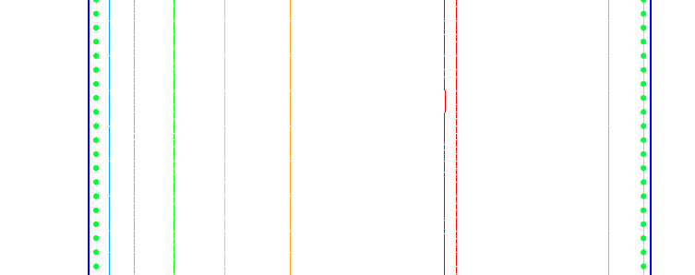
5c. Save and Run
Almost identical. Why?

Slide 26
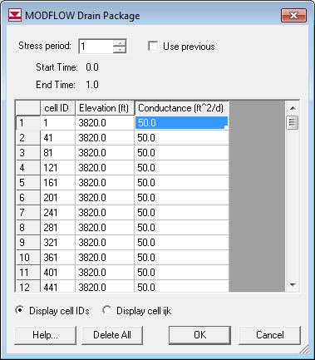
5d. Change conductance
K=.5, L=50, width=6, thickness=3
C = KA/L
C= 0.5*(50*6)/3=50
Change and double-click

Slide 27
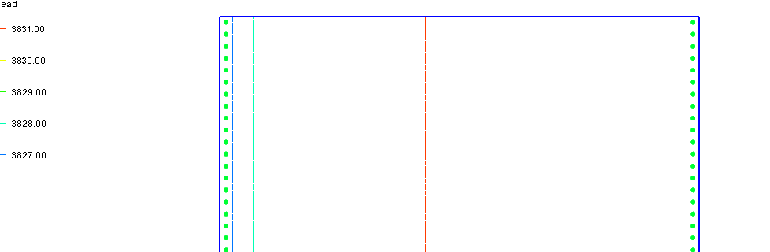
Compare
Heads are higher.

